Slide 1

Food Recipe Management System
Final Project Group 18
Vishakha Kishor Satpute CS7319 OnCampus
Chaitanya Rajendra Rathod CS7319 OnCampus

Slide 2
Table of content
Introduction
Layered Architecture Style
Microservice Architecture Style
Class Diagram
Pros and Cons
Rationale
Risk Analysis

Slide 3
Introduction
The Food Recipe Management System is a software solution designed to simplify meal planning, and recipe discovery by offering valuable features centered around recipe management. This project aims to enhance the culinary experience by providing a user-friendly platform that facilitates recipe organization, customization, and exploration.
The Food Recipe Management System seeks to address these challenges by offering the following key functionalities:
Login Page: Users will have the convenience of creating a new account
Uploading a Recipe: Users are empowered to contribute to the recipe database by uploading their unique recipes.
Editing a Recipe: Users can easily modify and enhance existing recipes
Searching a Recipe: The system provides a search function that allows users to discover recipes based on its ingredients.
Display of Recipe: The main page of the system presents users with a visually appealing and user-friendly display of a curated list of recipes.

Slide 4
Layered architectural style
Frontend: HTML and CSS
User Registration
User Login
User Authentication
User Database
Recipe Upload
Searching a Recipe
Editing a Recipe
Deleting a Recipe
Recipe Database

Slide 5
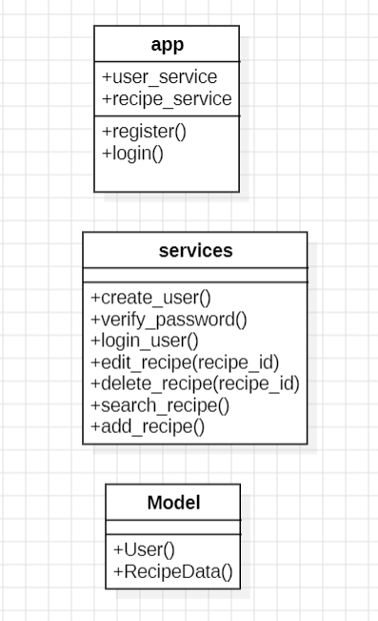
Class Diagram

Slide 6
Microservices Architecture style
Frontend: HTML and CSS
User Services
Recipe Management Services
User Registration
User Login
Recipe Upload
Searching a Recipe
Editing a Recipe
Deleting a Recipe
User Database
User Authentication
Recipe Database

Slide 7
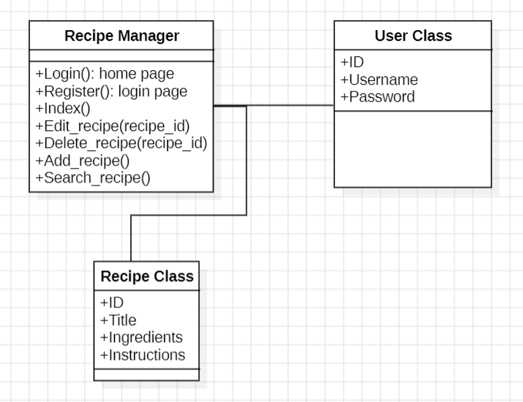
Class Diagram

Slide 8
Pros and Cons
 | Pros | Cons
Microservices Architecture | Modularity and Scalability | Communication Overhead
Layered Architecture | Less Operational Overhead | Scaling Challenges

Slide 9
Rationale Microservices Architecture
We believe that microservices architecture is the most suitable architecture for our project.
In microservices architecture, services are deployed individually. We can modify the services as they are not dependent on each other.
Using microservices improves fault isolation. Usually, if one service fails, the entire program is not affected. This improves the availability and fault tolerance of the system as a whole which is not the case in layered architecture.

Slide 10
Risk Analysis
Microservices Architecture Style:
Security Risks: Security vulnerabilities can be introduced at various points of interaction between microservices.
Service Interdependencies: Microservices may have dependencies on other services, and changes in one service can affect others.
Layered Architecture style
Scalability Limitations: Scaling a monolithic application can be challenging. You may need to scale the entire application even if only a specific part requires additional resources.
Limited Technology Choices: In a layered architecture, you're typically limited to a single technology stack for the entire application.

Slide 11
Thankyou

